Slide 1

Blinkit Data Analysis & Interactive Dashboard
📘 Project Title Blinkit Data Analysis & Interactive Dashboard

Slide 2
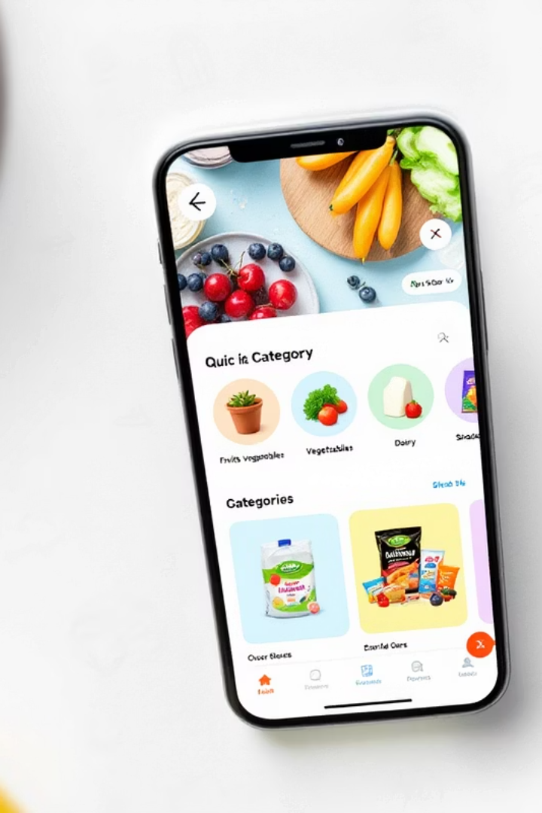
Project Objective
🎯 Primary Goal
To analyze Blinkit's sales, customer satisfaction, and inventory performance using Excel-based dashboards. The goal is to uncover patterns, optimize operations, and enable smarter decisions with interactive KPI and chart visualizations.

Slide 3


Project Requirements
📋 Project Requirements
Comprehensive analysis framework for Blinkit's operational data
Notes:
• The key focus of this slide is Blinkit's project requirements - a comprehensive analysis framework for their operational data. • This framework will provide a structured approach to analyzing Blinkit's data and extracting valuable insights. • The goal is to gain a deeper understanding of Blinkit's operations, identify areas for improvement, and make data-driven decisions. • This analysis will cover a wide range of factors, from customer behavior to supply chain efficiency, to help Blinkit optimize their business. • The project requirements outlined here serve as the foundation for the upcoming work, ensuring a thorough and well-planned approach.

Slide 4
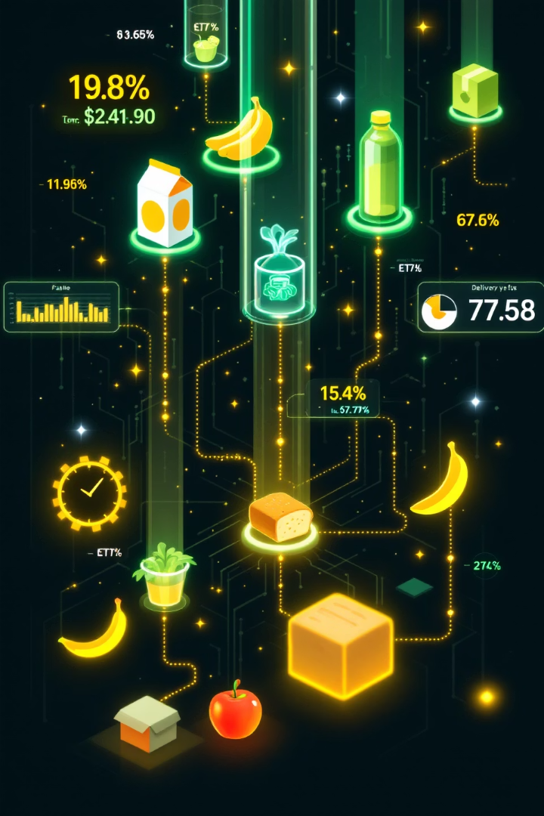




KPI Requirements
Total Sales
Average Sales
Number of Items
Overall revenue from all items
Average revenue per item sold
Total number of unique items sold
Average Rating
Average customer satisfaction score
✅ KPI's Requirements Total Sales: Overall revenue from all items. Average Sales: Average revenue per item sold. Number of Items: Total number of unique items sold. Average Rating: Average customer satisfaction score.

Slide 5
Chart Requirements
Total Sales by Fat Content
1
Objective: Measure how fat levels impact overall sales. Chart: Donut Chart
2
Total Sales by Item Type
Objective: Compare item category performance. Chart: Bar Chart
Fat Content by Outlet
3
Objective: Analyze fat-based sales across outlets. Chart: Stacked Column Chart
4
Sales by Outlet Establishment
Objective: See how outlet age/type affects sales. Chart: Line Chart
Sales by Outlet Size
5
Objective: Explore sales based on outlet size. Chart: Donut/Pie Chart
6
Sales by Outlet Location
Objective: Assess regional sales distribution. Chart: Funnel Map
All Metrics by Outlet Type
7
Objective: View key metrics across outlet types. Chart: Matrix Card
✅ Chart's Requirements Total Sales by Fat Content Objective: Measure how fat levels impact overall sales. Chart: Donut Chart Total Sales by Item Type Objective: Compare item category performance. Chart: Bar Chart Fat Content by Outlet Objective: Analyze fat-based sales across outlets. Chart: Stacked Column Chart Sales by Outlet Establishment Objective: See how outlet age/type affects sales. Chart: Line Chart Sales by Outlet Size Objective: Explore sales based on outlet size. Chart: Donut/Pie Chart Sales by Outlet Location Objective: Assess regional sales distribution. Chart: Funnel Map All Metrics by Outlet Type Objective: View key metrics across outlet types. Chart: Matrix Card

Slide 6
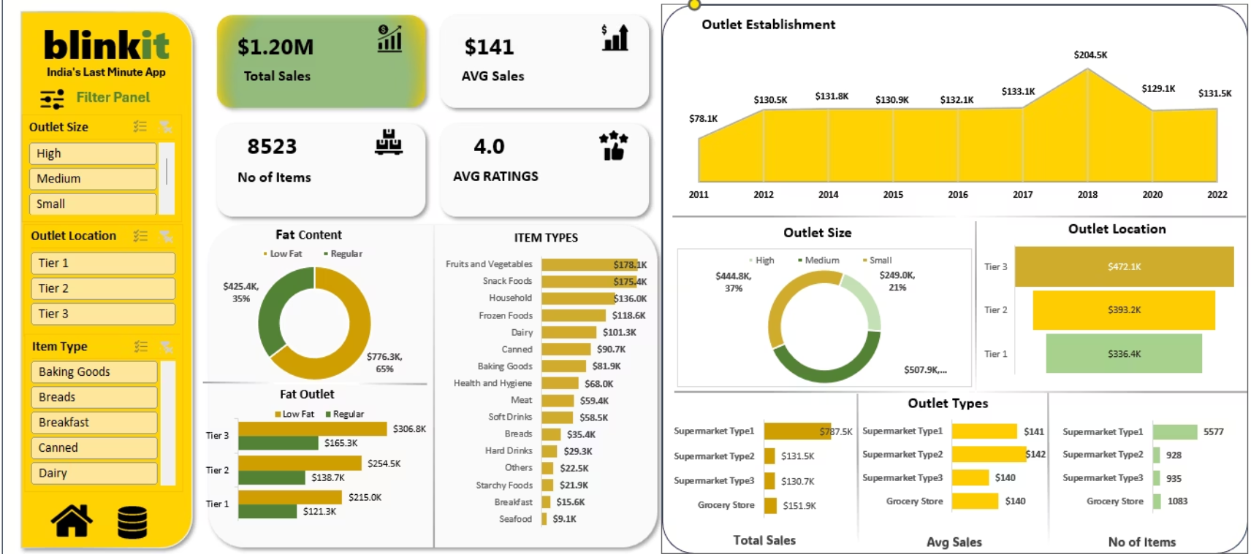
Dashboard

Slide 7
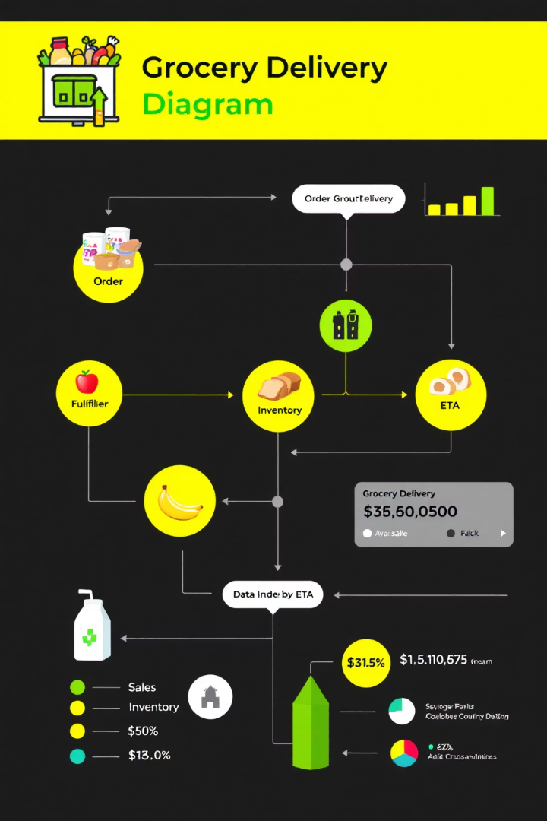




Dashboard Functionality
Filter Options
Filter by Outlet Size, Location, and Item Type
Dynamic KPIs
View dynamic KPIs: Total Sales, Avg Sales, Ratings, and No. of Items
Performance Analysis
Analyze fat content, outlet type, and item-level performance
Drill Down Capability
Drill down into outlet categories to find performance differences
💡 Dashboard Functionality The dashboard allows users to: Filter by Outlet Size, Location, and Item Type View dynamic KPIs: Total Sales, Avg Sales, Ratings, and No. of Items Analyze fat content, outlet type, and item-level performance Drill down into outlet categories to find performance differences

Slide 8

Project Insights
65%
37%
Regular Fat Content
High Outlet Size
Generated 65% of sales, showing strong demand
Contributed 37% of the total revenue
2018
Peak Year
Recorded the highest sales
📈 Project Insights Based on the dashboard: Regular fat content items generated 65% of sales, showing strong demand. Tier 3 outlets had the highest total sales across regions. High outlet size contributed 37% of the total revenue. Fruits & Vegetables and Snack Foods are top-selling categories. The year 2018 recorded the highest sales, indicating a potential peak year or successful campaign.

Slide 9
Strategic Business Recommendations
Prioritize High-Performing Categories
Focus on top-selling items like fruits and snacks; trim low-performing products to optimize inventory.
Expand in High-Growth Areas
Tier 3 outlets and larger outlet sizes drive the most revenue—consider scaling operations in these segments.
Targeted Customer Engagement
Leverage fat content preferences and item ratings to tailor marketing and improve customer satisfaction.
Location-Based Strategy
Use geographic sales data to design region-specific promotions and outlet upgrades.
Data-Driven Growth Planning
Track annual trends and outlet performance to inform expansion and product strategy.
🔍 Strategic Business Recommendations from Dashboard Insights Prioritize High-Performing Categories Focus on top-selling items like fruits and snacks; trim low-performing products to optimize inventory. Expand in High-Growth Areas Tier 3 outlets and larger outlet sizes drive the most revenue—consider scaling operations in these segments. Targeted Customer Engagement Leverage fat content preferences and item ratings to tailor marketing and improve customer satisfaction. Location-Based Strategy Use geographic sales data to design region-specific promotions and outlet upgrades. Data-Driven Growth Planning Track annual trends and outlet performance to inform expansion and product strategy.

Slide 10




Conclusion
Key Insights
Regional Trends
Highlights high-performing products and outlet efficiency
Identifies geographic performance patterns
Strategic View
Data-Driven Decisions
Delivers comprehensive analysis of Blinkit's operations
Empowers stakeholders with real-time insights
2
3
1
4
✅ Conclusion This analysis delivers a strategic view of Blinkit's operations. The insights highlight high-performing products, outlet efficiency, and regional trends. The dashboard empowers stakeholders to make real-time, data-informed decisions.

Slide 11
Thank You
Presented by
Contact
Dharmesh Parmar
Email ID: Dhparmar2119@gmail.com

